Slide 1
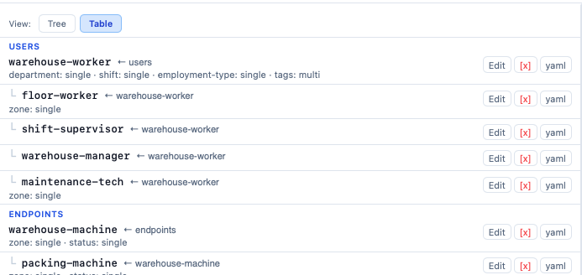
ZPR Policy Builder
User. | User Guide. |. Profile. | Sign out
NameSpace Pulldown selector
ZPL Editor
NameSpace
Entity - Class
Save
Clear
Policy Editor
Input New ZPL
AI Assist
ZPL
Table
Show ALL
Delete ALL
Policy Audit (Rule Analyst)
Definitions (classes and Rules)
Testing
Namespace
Manager
Reports
Home page

Slide 2
ZPR Policy Builder
NameSpace Pulldown selector
Testing Page
Policy Editor
Manual Test
Add
Subject. Access. object
AI Assist
Testing
Test Generator
Generate
Run
Policy Audit
Namespace
Manager
Reports
Testing Page

Slide 3
ZPR Policy Builder
NameSpace Pulldown selector
AI Assistant
Policy Editor
Type in ZPL
Check
AI Assist
Testing
Session conversation
Define cat as an animal
Define worker as employee
Policy Audit
Animal is not a valid class, want me to create it
Namespace
Manager
Define worker as a corp.employee
Accept. | Edit. | Delete
Reports
AI Assistant

Slide 4
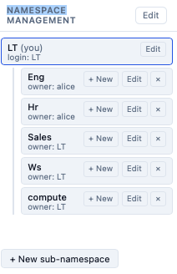
ZPR Policy Builder
NameSpace Pulldown selector
Name space Manager
Policy Editor
AI Assist
Testing
Policy Audit
Namespace
Manager
Reports
Namespace Manager Page

